Slide 1
POWERS OF 10
ZOOM
FROM MICRO TO MACRO COSMOS
.

Slide 2
This is a trip at high speed,
jumping distances by a factor of 10.
We’ll start with 10⁰ (equivalent to 1 meter), and will increase the size by a factor of 10, or 10¹ (10 meters), 10² (10x10 = 100 meters, 10³ (10x10x10 = 1,000 meters), 10⁴ (10x10x10x10 = 10,000 meters), so on, until we reach the limit of our imagination in the direction of the macro cosmos.
Later we’ll return, a little faster, back to the point where we started & continue our trip in the opposite direction reducing distances of travel by factors of 10 into the micro cosmos.
We will observe the constancy of the laws of the universe and think about how much the human race still needs to learn...

Slide 3
BON VOYAGE!

Slide 4
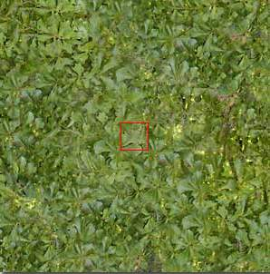
10⁰
^{1 meter}
Distance
to a bunch of leaves
in the garden

Slide 5
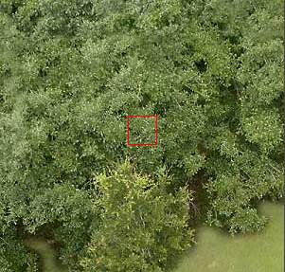
10¹
10 meters
Starting our trip upwards ....
We can see the foliage.

Slide 6
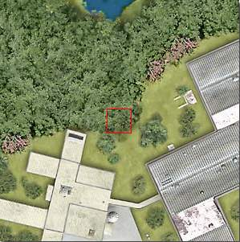
10²
100 meters
At this distance we can see the limits of the forest and the edifications

Slide 7
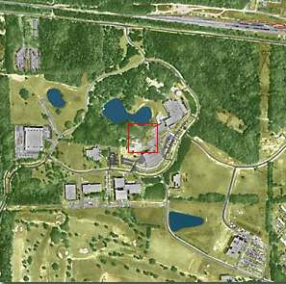
10³
1 km
We will pass from meters to kilometers..
Now it is possible to jump with a parachute ...

Slide 8
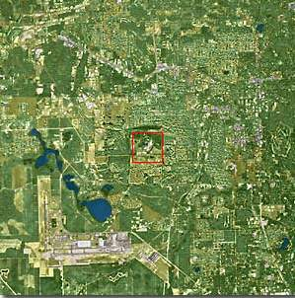
10⁴
10 km
The city could be observed but we really can’t see the houses

Slide 9
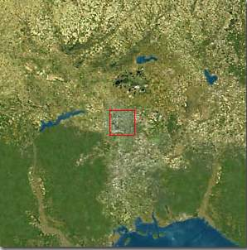
10⁵
100 km
At this height, the state of Flórida - USA, is just coming into view ...

Slide 10
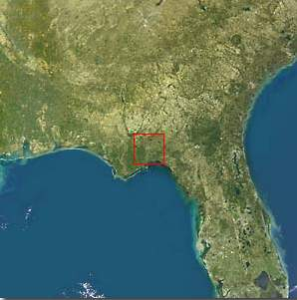
10⁶
1,000 km
Typical sight from a satellite

Slide 11
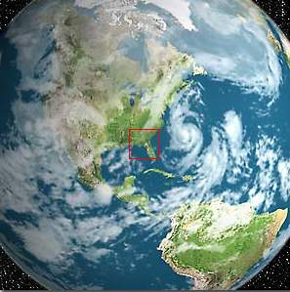
10⁷
10,000 km
The northern hemisphere of Earth, and part of South America

Slide 12
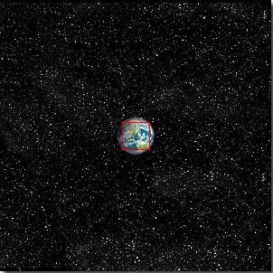
10⁸
100,000 km
The Earth starts looking small...

Slide 13
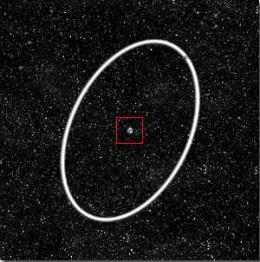
10⁹
1 Millión km
The Earth and the Moon’s órbit in white....

Slide 14
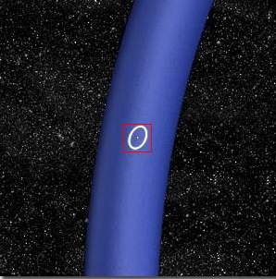
10¹⁰
10 Million km
Part of the Earth’s Orbit in blue

Slide 15
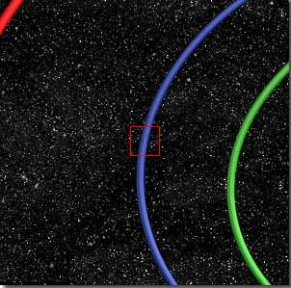
10¹¹
100 Million km
Órbits of: Venus and
Earth...

Slide 16
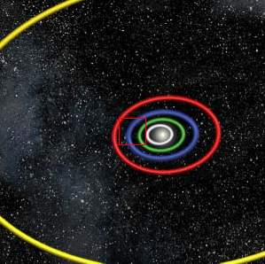
10¹²
1 Billión km
Órbits of: Mercury, Venus, Earth, Mars and Júpiter.

Slide 17
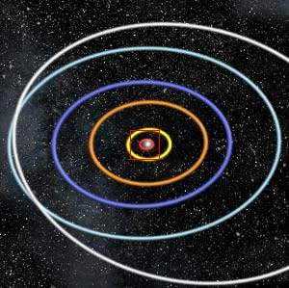
10¹³
10 Billion km
At this height of our trip, we could observe the Solar System and the orbits of the planets

Slide 18
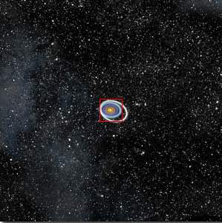
10¹⁴
100 Billion km
The Solar System starts looking small...

Slide 19
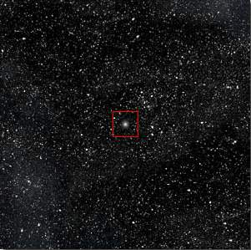
10¹⁵
1 Trillión km
The Sun now is a small star in the middle of thousands of stars...

Slide 20
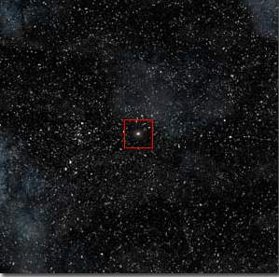
10¹⁶
1 light-year
At one light-year the little Sun star is very small

Slide 21
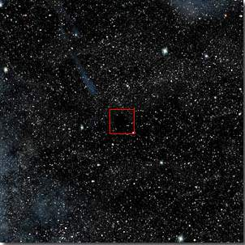
10¹⁷
10 light-years
Here we will see nothing in the infinity....

Slide 22
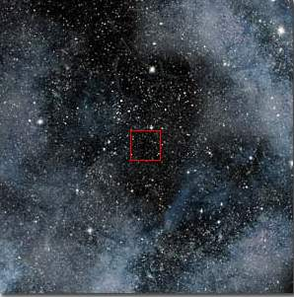
10¹⁸
100 light-years
“Nothing”
Only stars and Nebulae...

Slide 23
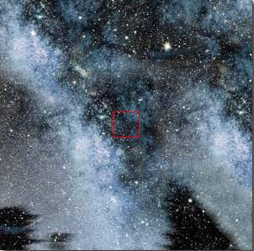
10¹⁹
1,000 light-years
At this distance we are travelling in the Via-Láctea (Milky Way), our galaxy.

Slide 24
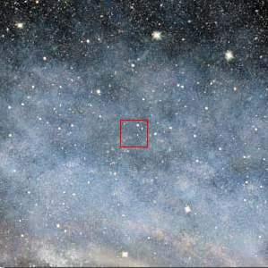
10²⁰
10,000 light-years
We continue our travel inside the Via-Láctea
(Milky Way)

Slide 25
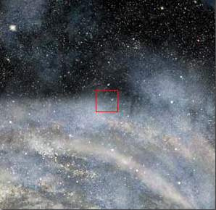
10²¹
100,000 light-years
We begin reaching the periphery of the Via-Láctea
(Milky Way)

Slide 26
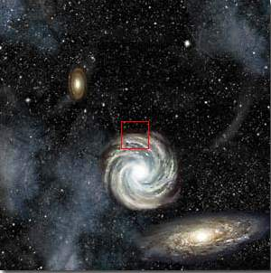
10²²
1 Millión light-years
At this tremendous distance we can see the entire Via-Láctea (Milky Way) & other galáxies as well ...

Slide 27
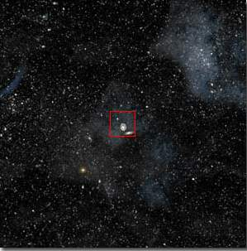
10²³ - 10 Million light-years
From this distance, all the galaxies look small with immense empty spaces in between.
The same laws are ruling all bodies of the Universe.
We could continue traveling upwards with our imagination, but now let’s return home quickly

Slide 28
10²²

Slide 29
10²¹

Slide 30
10²⁰

Slide 31
10¹⁹

Slide 32
10¹⁸

Slide 33
10¹⁷

Slide 34
10¹⁶

Slide 35
10¹⁵

Slide 36
10¹⁴

Slide 37
10¹³

Slide 38
10¹²

Slide 39
10¹¹

Slide 40
10¹⁰

Slide 41
10⁹

Slide 42
10⁸

Slide 43
10⁷

Slide 44
10⁶

Slide 45
10⁵

Slide 46
10⁴
Questions that come to mind ...
Who are we?
Where are we going?
Where did we come from?

Slide 47
10³
Or... What do we represent in the Universe?

Slide 48
10²
In this trip
“upwards” we went to the power of 23 of 10

Slide 49
10¹
Now we are going to dig inside of matter in a reverse (inverse) trip...

Slide 50
10⁰
We arrive at our starting point.
We could touch it with our hands ...

Slide 51
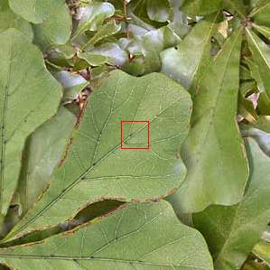
10⁻¹
10 Centímeters
Getting closer at 10 cm ...We can delineate the leaves.

Slide 52
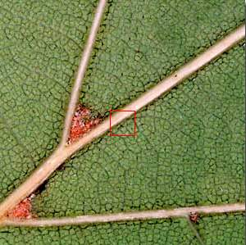
10⁻²
1 Centímeter
At this distance it is possible to observe the structure
of the leaf.

Slide 53
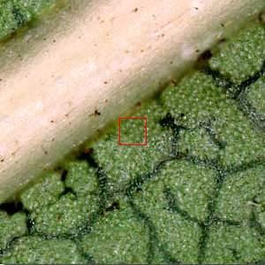
10⁻³
1 Millímeter
The cellular structures begin to show...

Slide 54
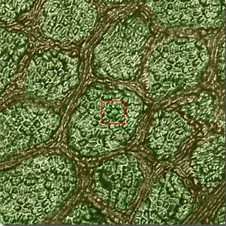
10⁻⁴
100 microns
The cells can be delineated.
You can see the union between them.

Slide 55
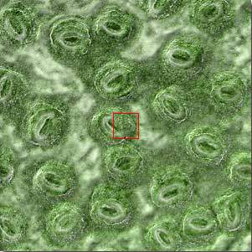
10⁻⁵
10 microns
Starting our trip inside the cell ...

Slide 56
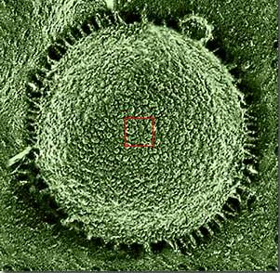
10⁻⁶
1 micrón
The nucleus of the cell is visible.

Slide 57
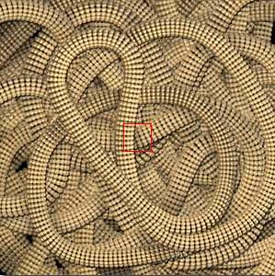
10⁻⁷
100 Nanometers
Again we changed the measuring unit to adapt to the miniscule size.
You can see the chromosomes.

Slide 58
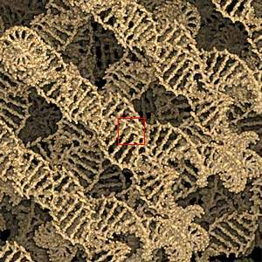
10⁻⁸
10 Nanometers
In this micro universe the DNA chain is visible.

Slide 59
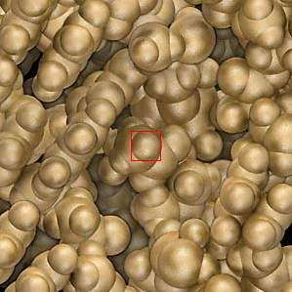
10⁻⁹
1 Nanometer
...the chromosóme blocks can be observed.

Slide 60
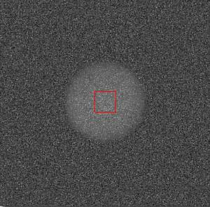
10⁻¹⁰
1 Angstrom
It appears like clouds of electrons... These are carbon átoms that formed our world.
You should notice the resemblance of the micro cosmos with the macro cosmos ...

Slide 61
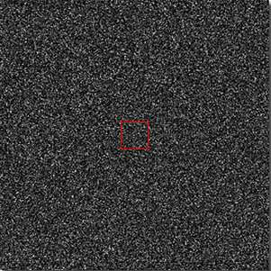
10⁻¹¹
10 Picometers
In this miniature world we could observe the electrons orbiting the atoms.

Slide 62
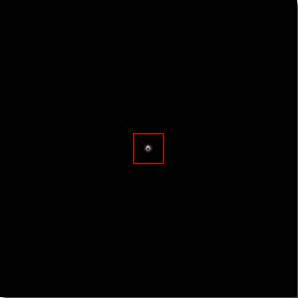
10⁻¹²
1 Picómeter
An immense empty space between the nucleus and the electron orbits...

Slide 63
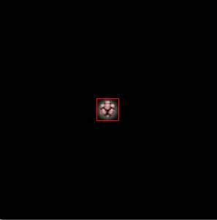
10⁻¹³
100 Femtómeters
At this incredible and minuscule size we could observe the nucleus of the atom.

Slide 64
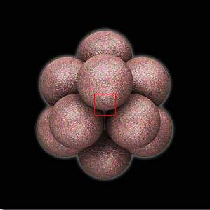
10⁻¹⁴
10 Femtómeters
Now we could observe the nucleus of the carbon atom

Slide 65
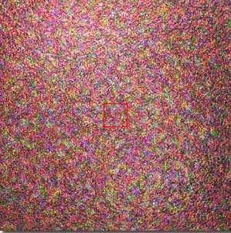
10⁻¹⁵
1 Femtómeter
Here we are in the field of the scientific imagination, face to face with a proton.

Slide 66
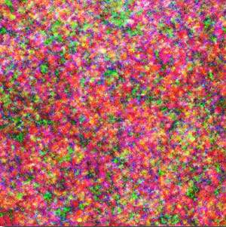
10⁻¹⁶
100 Attómeters
Examine the ‘quark’ partícules
There is nowhere further to go...
We are at the limits of current scientific knowledge .
This is the limit of matter...

Slide 67
And now ...
Are you the center of the universe?
Are you the special creature of the Creatión?
What is behind the limits? Are there any limits?
Note that going downwards we could only go to the power of minus 16ª of 10 to reach the (known?) limits of matter... But upwards we went to the power of 23ª of 10 and stopped... But we could have continued our trip subject only to the limits to our imagination!!!!
... then?
... Who says that we are alone in the universe?

Slide 68
Hope you
enjoyed the trip.
The End!

